Slide 1
Data Poisoning Attacks and Defenses
Xue Hu

Slide 2


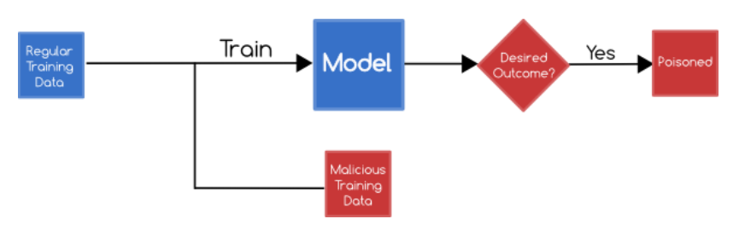
Adversarial Examples
Classified as panda
Small adversarial noise
Classified as gibbon

Slide 3
Data Poisoning Attacks
Evasion attacks vs poisoning attacks
Evasion attacks aims to find evaded data, where the data is trained already.
Poisoning attacks aims to attack the model itself, i.e. to do modifications to the training data.
The poisoned model can be either white-box or black box.

Slide 4
Types of Data Poisoning Attacks
Four types of poisoning:
Label modification attacks: For binary classifiers, it is usually known as a label flipping attack.
Poison insertion attacks
Data modification attacks
Boiling frog attacks: In these attacks, the defender is assumed to iteratively modify and retrain a model.
Two kinds of goals:
targeted attacks: targeted on a specific collection of data.
reliability attacks: to maximize the overall prediction error.

Slide 5
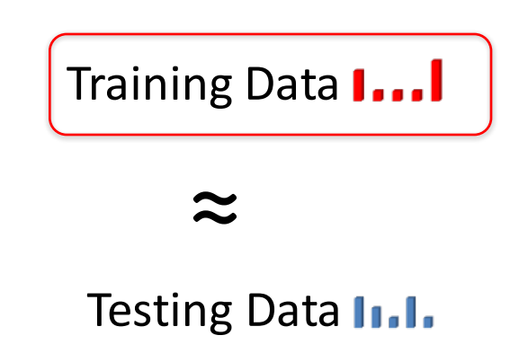
Traditional machine learning approaches assume

Slide 6
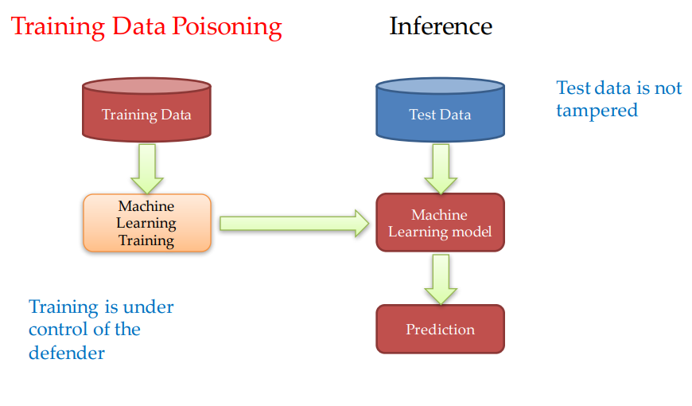

Slide 7


Modelling Poisoning Attacks
The original training data, denote by $𝒟_{0}$, will be transformed into$𝒟$, through poisoning on a target set of instances $S$.

Slide 8


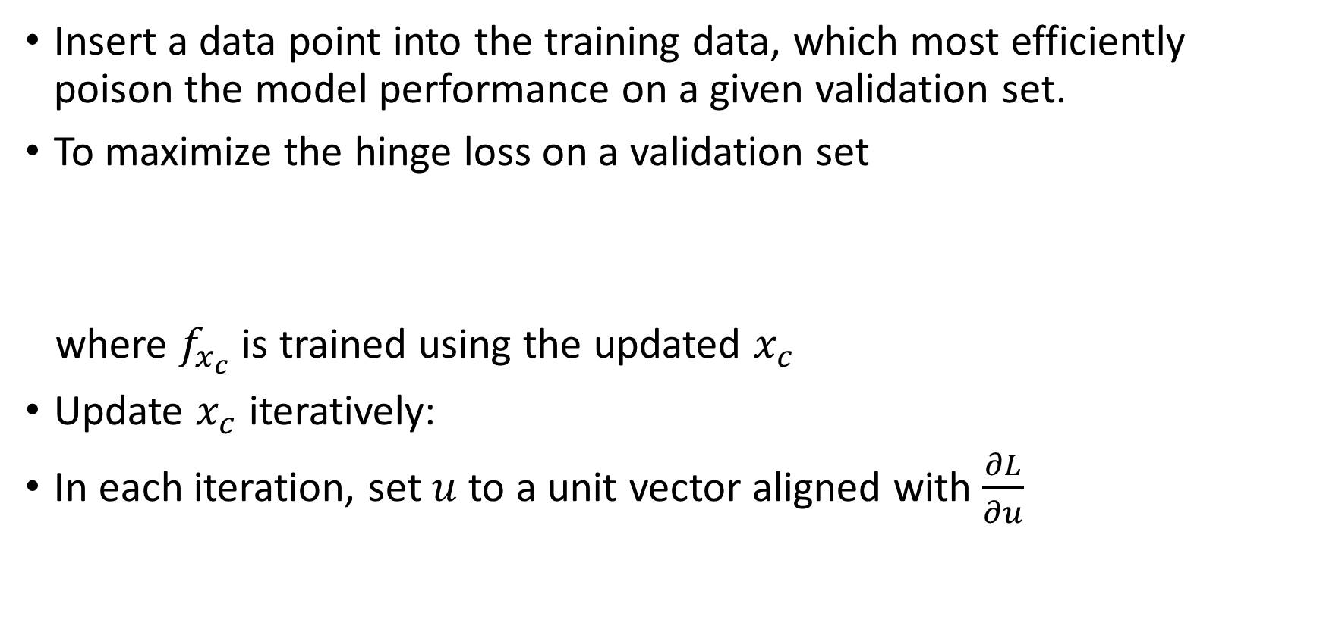
Single Point Poisoning Against SVM
Insert a data point into the training data, which most efficiently poison the model performance on a given validation set.
To maximize the hinge loss on a validation set
where $f_{x_{c}}$ is trained using the updated $x_{c}$
Update $x_{c}$ iteratively:
In each iteration, set $u$to a unit vector aligned with $\frac{∂L}{∂u}$

Slide 9
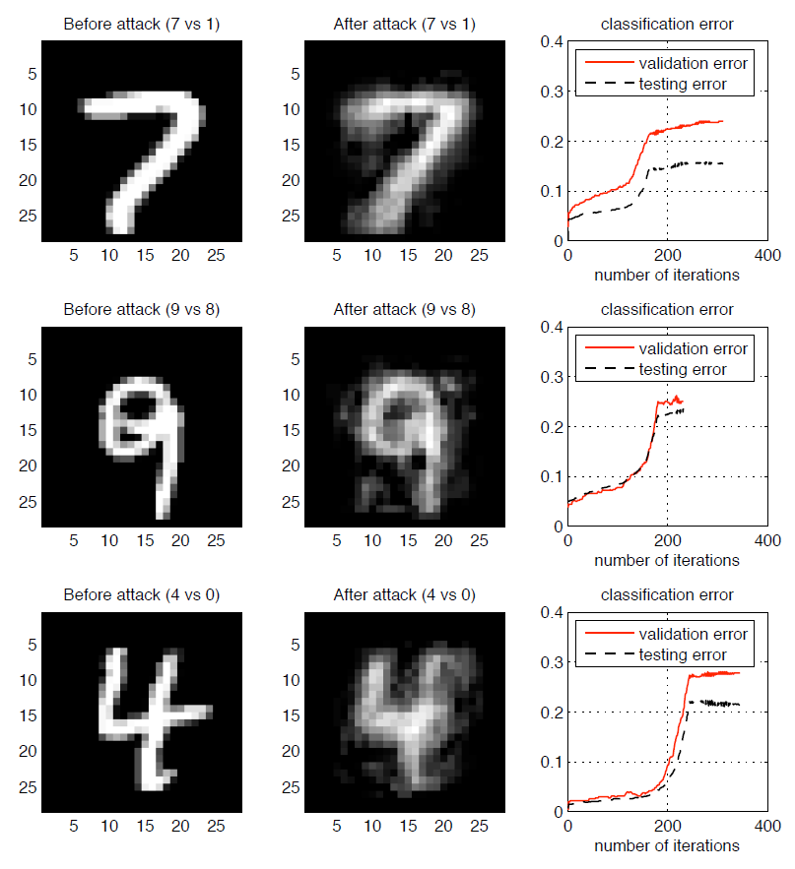
Single Point Poisoning Against SVM
The experiments show that the validation error and testing error are both increased due to the attack.
The perturbation forces the original image to be more like the opposite class.
A single attack data point caused the classification error to rise from the initial error rates of 2-5% to 15-20%.

Slide 10
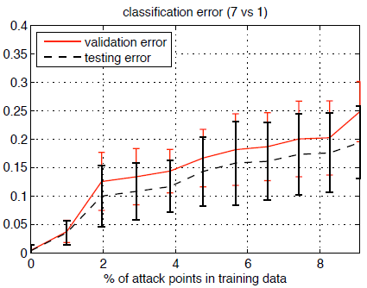
Single Point Poisoning Against SVM
Future work:
Add constraint to the perturbation.
Multi-point Poisoning: finding the optimal subset to attack.
Incorporate inverse feature mapping problem.
Extension to Multi-point Poisoning

Slide 11
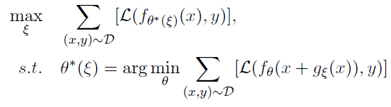
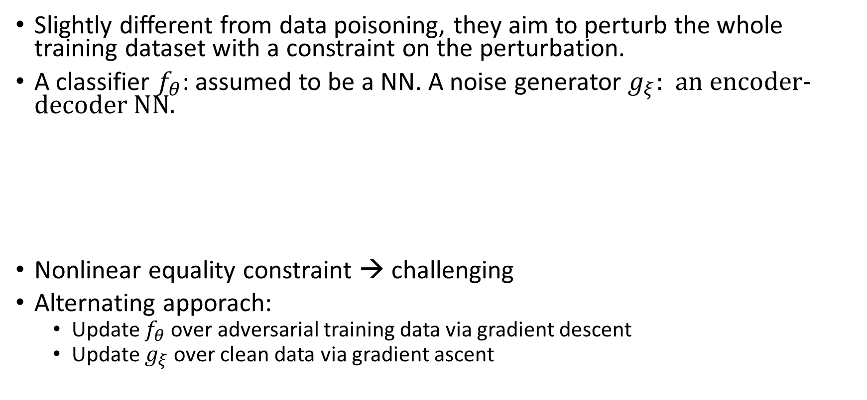
Learning to Confuse: Generating Training Time Adversarial Data with Auto-Encoder
Slightly different from data poisoning, they aim to perturb the whole training dataset with a constraint on the perturbation.
A classifier $f_{θ}$: assumed to be a NN. A noise generator $g_{ξ}:$ an encoder-decoder NN.
Nonlinear equality constraint → challenging
Alternating apporach:
Update $f_{θ}$ over adversarial training data via gradient descent
Update $g_{ξ}$over clean data via gradient ascent

Slide 12
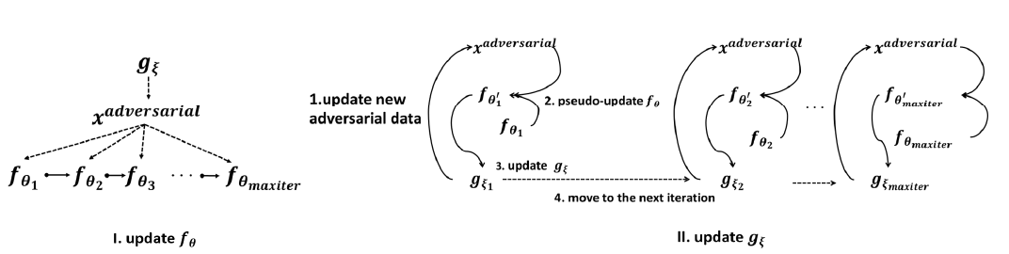

Learning to Confuse: Generating Training Time Adversarial Data with Auto-Encoder
The main problem is that, if directly using this alternating approach, both networks $f$ and $g$ won't converge in practice.

Slide 13
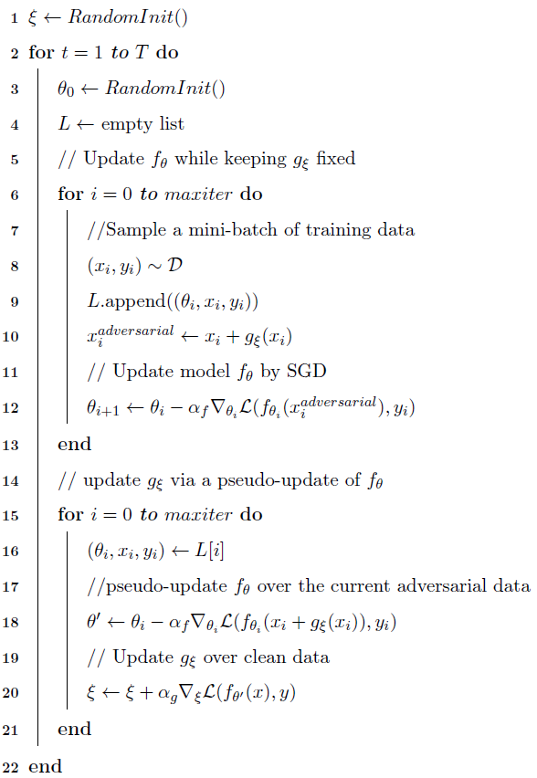
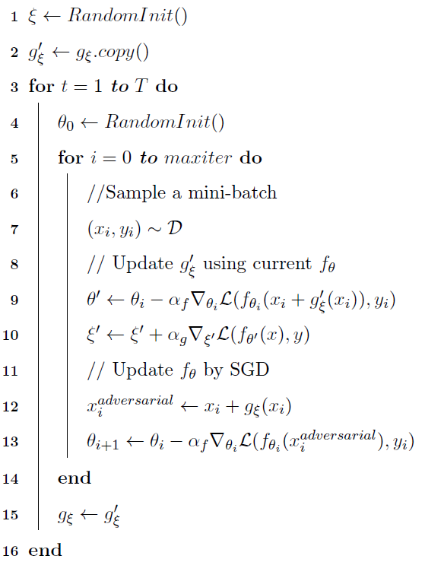
A More Efficient Way

Slide 14
Learning to Confuse: Generating Training Time Adversarial Data with Auto-Encoder
Summary:
Can be extended to label-specific/targeted scenarios.

Slide 15
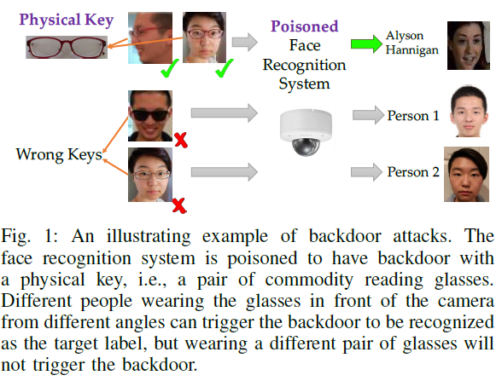
Targeted Backdoor Attacks on Deep Learning Systems Using Data Poisoning
Notes:
A traditional backdoor in an operating system or an application refers to a piece of malicious code embedded by an attacker into such systems,
obtain higher privilege
often difficult to detect
behave completely normally on normal inputs and only behave wrongly on certain malicious inputs (such as the attacker’s password) that trigger the backdoor.
One interesting truth is that, here the attack is physical attack. The glasses are physically worn by the person. While in previous works, usually the perturbation is added via adding noisy pixel values.

Slide 16
Targeted Backdoor Attacks on Deep Learning Systems Using Data Poisoning
The attacker injects poisoning samples into the training.
Can be applied under a very weak threat model:
The attacker has no knowledge of the model and the training set;
The attacker is allowed to inject only a small amount of poisoning samples;
The backdoor key is hard to notice even by human beings.
The backdoor attack does not affect the overall performance of model. Instead, it focuses on targeted attacks.

Slide 17
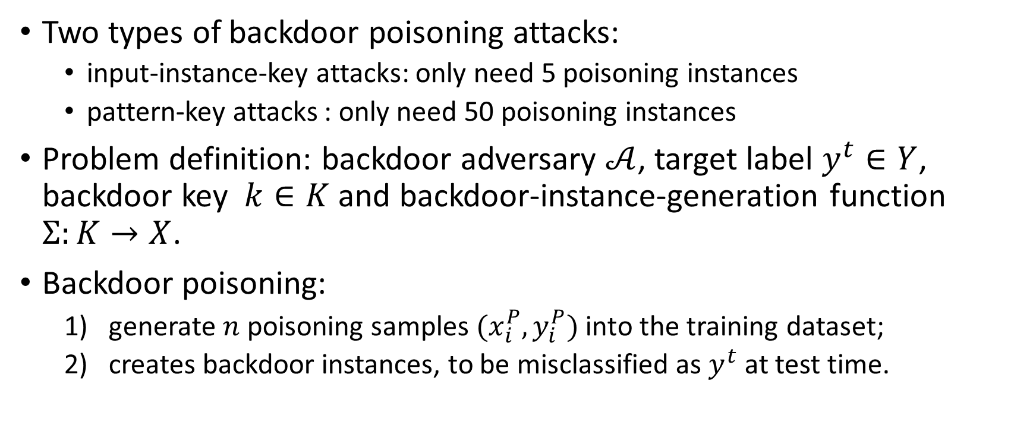
Targeted Backdoor Attacks on Deep Learning Systems Using Data Poisoning
Two types of backdoor poisoning attacks:
input-instance-key attacks: only need 5 poisoning instances
pattern-key attacks : only need 50 poisoning instances
Problem definition: backdoor adversary $𝒜$, target label $y^{t}∈Y$, backdoor key $k∈K$ and backdoor-instance-generation function $Σ:K→X$.
Backdoor poisoning:
generate $n$ poisoning samples $(x_{i}^{P},y_{i}^{P})$ into the training dataset;
creates backdoor instances, to be misclassified as $y^{t}$ at test time.
Notes:
input instance-key attacks create a set of backdoor instances that are similar to one single input instance;
pattern-key attacks create a set of backdoor instances sharing the same pattern.

Slide 18


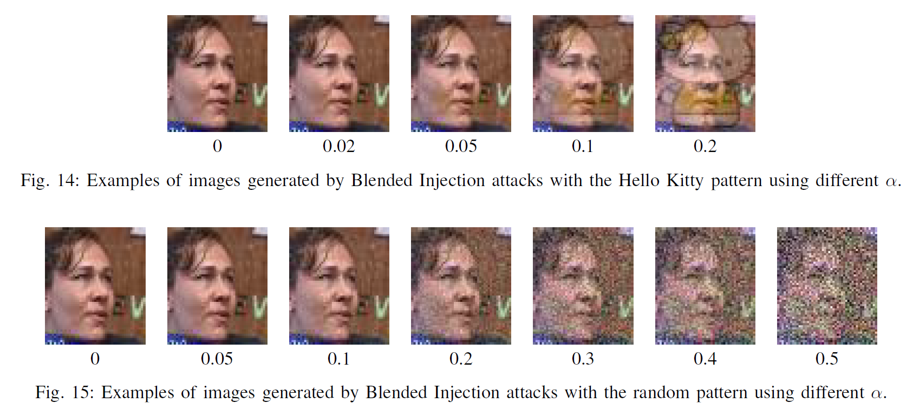

Targeted Backdoor Attacks on Deep Learning Systems Using Data Poisoning
Input-instance-key strategies
Pattern-key strategies
Pattern injection function $Π:K×X→X$
Blended Injection Strategy
Notes:
Input-instance-key can be the face of the attacker.
all the generated backdoor instances look similar to the
to key k to a human
causes the victim model to achieve a high attack success rate on a class of backdoor instances sharing the same pattern.

Slide 19
Targeted Backdoor Attacks on Deep Learning Systems Using Data Poisoning
Evaluation metrics
Attack success rate should be high
Standard test accuracy, the accuracy on the pristine test data should be similar to that of the non-poisoned model.
Attack success rate with a wrong key should be low
Notes:
Input-instance-key can be the face of the attacker.
all the generated backdoor instances look similar to the
to key k to a human
causes the victim model to achieve a high attack success rate on a class of backdoor instances sharing the same pattern.

Slide 20
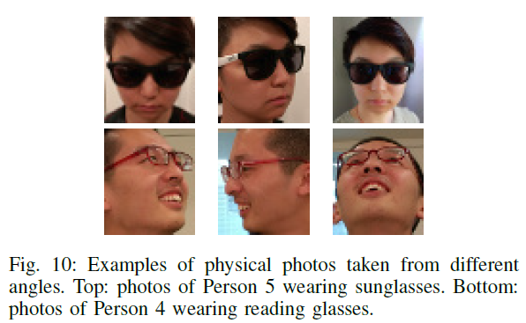
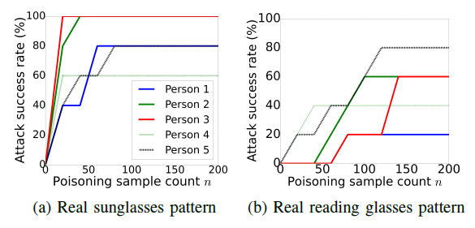
Targeted Backdoor Attacks on Deep Learning Systems Using Data Poisoning
Physical attacks
Notes:
Input-instance-key can be the face of the attacker.
all the generated backdoor instances look similar to the
to key k to a human
causes the victim model to achieve a high attack success rate on a class of backdoor instances sharing the same pattern.

Slide 21
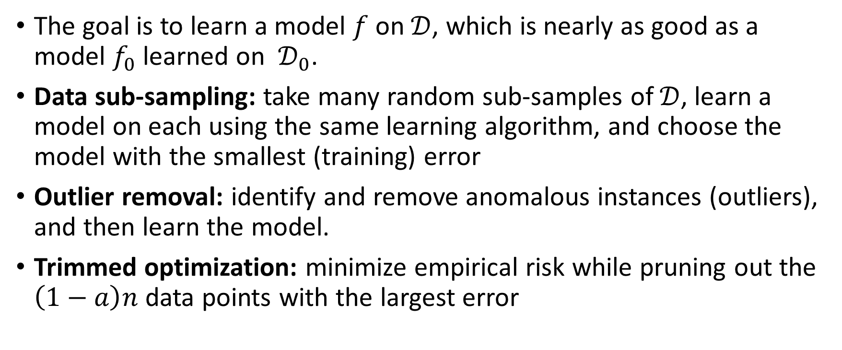
Defending Against Data Poisoning
The goal is to learn a model $f$ on$𝒟$, which is nearly as good as a model $f_{0}$ learned on $𝒟_{0}$.
Data sub-sampling: take many random sub-samples of $𝒟$, learn a model on each using the same learning algorithm, and choose the model with the smallest (training) error
Outlier removal: identify and remove anomalous instances (outliers), and then learn the model.
Trimmed optimization: minimize empirical risk while pruning out the $\left(1−a\right)n$ data points with the largest error

Slide 22
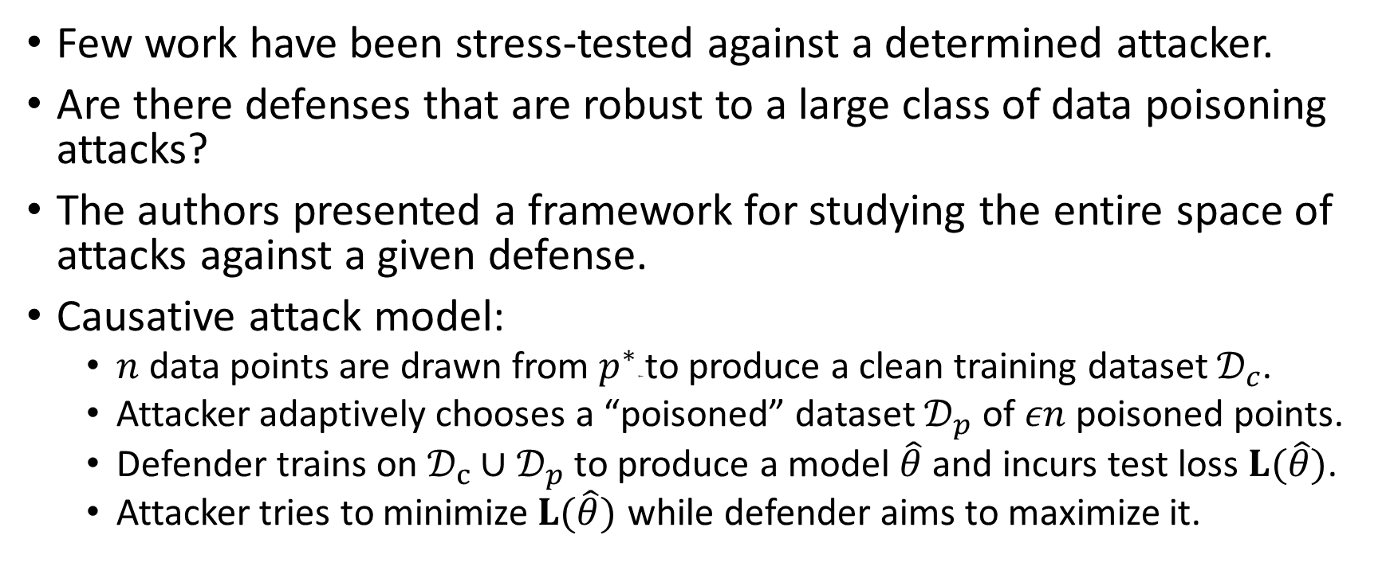
Certified Defenses for Data Poisoning Attacks
Few work have been stress-tested against a determined attacker.
Are there defenses that are robust to a large class of data poisoning attacks?
The authors presented a framework for studying the entire space of attacks against a given defense.
Causative attack model:
$n$ data points are drawn from $p^{∗}$⇤ to produce a clean training dataset $𝒟_{c}$.
Attacker adaptively chooses a “poisoned” dataset $𝒟_{p }$ of $εn$poisoned points.
Defender trains on $𝒟_{c}∪𝒟_{p}$to produce a model $\hat{θ}$and incurs test loss $L(\hat{θ})$.
Attacker tries to minimize$L(\hat{θ})$ while defender aims to maximize it.

Slide 23

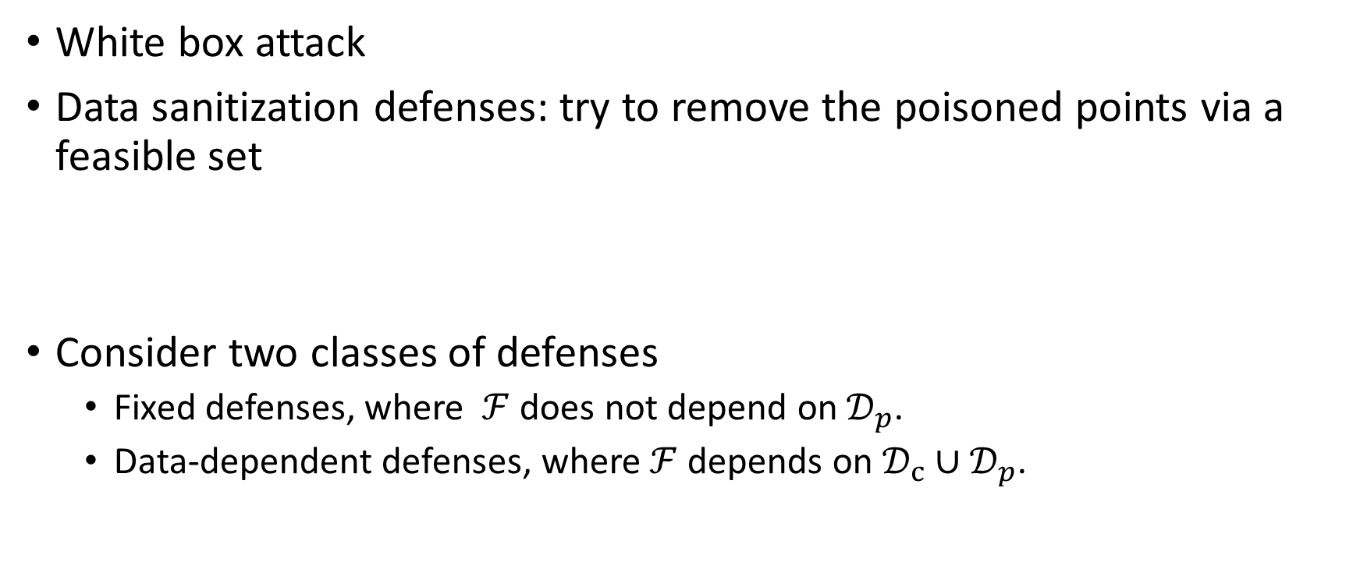
Certified Defenses for Data Poisoning Attacks
White box attack
Data sanitization defenses: try to remove the poisoned points via a feasible set
Consider two classes of defenses
Fixed defenses, where $ℱ$ does not depend on $𝒟_{p}$.
Data-dependent defenses, where$ℱ$ depends on $𝒟_{c}∪𝒟_{p}$.

Slide 24

Certified Defenses for Data Poisoning Attacks
A natural defense strategy is to remove points that are too far away from the corresponding centroid of each class.
The training loss on clean training data should be upper bounded by the loss on the full data.

Slide 25

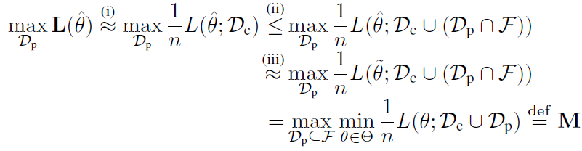
Certified Defenses for Data Poisoning Attacks
Then they have the defender train on

Slide 26
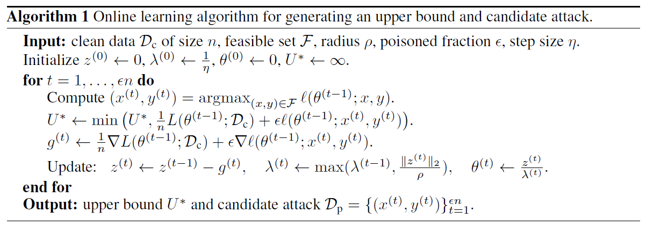
Certified Defenses for Data Poisoning Attacks
Fixed defenses: computing the minimax loss via online learning

Slide 27
Certified Defenses for Data Poisoning Attacks
Data-dependent defenses: upper and lower bounds

Slide 28
References
Vorobeychik, Yevgeniy, and Murat Kantarcioglu. "Adversarial machine learning." Synthesis Lectures on Artificial Intelligence and Machine Learning 12.3 (2018): 1-169.
Biggio, B., Nelson, B., & Laskov, P. Poisoning attacks against support vector machines. ICML. 2012.
Feng, Ji, Qi-Zhi Cai, and Zhi-Hua Zhou. "Learning to Confuse: Generating Training Time Adversarial Data with Auto-Encoder." NeurIPS. 2019.
Steinhardt, Jacob, Pang Wei W. Koh, and Percy S. Liang. "Certified defenses for data poisoning attacks." NIPS. 2017.

